Slide 1
Object-Oriented Programming (OOP)
Week – 09
April 13-17, 2020
Instructor: Basit Ali
Email: basit.jasani@nu.edu.pk
Object-Oriented Programming (OOP)

Slide 2
Friend Function & Friend Class

Slide 3
Friend Function
A friend function of a class is defined outside that class' scope but it has the right to access all private and protected members of the class.
Even though the prototypes for friend functions appear in the class definition, friends are not member functions.

Slide 4
Friend Function
To declare a function as a friend of a class, precede the function prototype in the class definition with keyword friend as follows

Slide 5
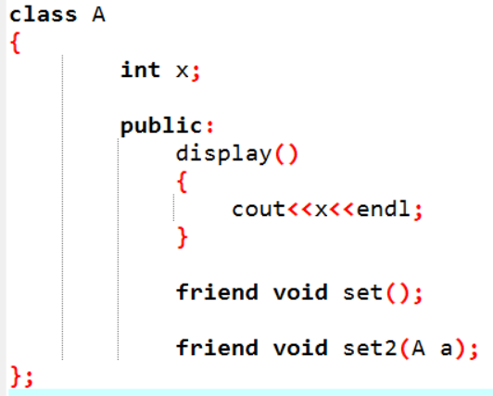
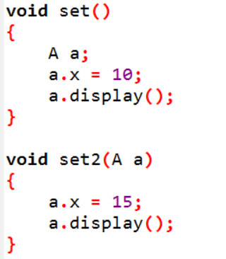
Implementation

Slide 6
Friend Class
like a friend function, a class can also be made a friend of another class using keyword.
A friend class can access all the private and protected members of other class.
In order to access the private and protected members of a class into friend class we must pass on object of a class to the member functions of friend class.
When a class is made a friend class, all the member functions of that class becomes friend functions.

Slide 7
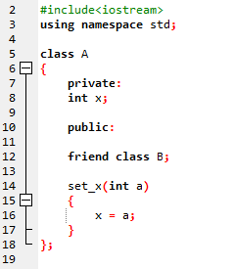
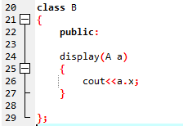
Example!

Slide 8
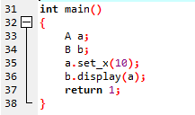
Continue..

Slide 9
Generic Programming!
Generic Programming is the idea to allow type (Integer, String, … etc and user-defined types) to be a parameter to methods, classes and interfaces.
The method of Generic Programming is implemented to increase the efficiency of the code

Slide 10
Generic Programming!
Generic Programming enables the programmer to write a general algorithm which will work with all data types.
It eliminates the need to create different algorithms if the data type is an integer, string or a character.

Slide 11
The advantages of Generic Programming
Code Reusability
Avoid Function Overloading
Once written it can be used for multiple times and cases.

Slide 12
Generics
Generics can be implemented in C++ using Templates.
Templates!

Slide 13
Function Templates
The general form of a template function definition is:
template <class T>
ret-type function-name(parameters)
{
// body of function
}
T is a placeholder that the compiler will automatically replace with an actual data type

Slide 14
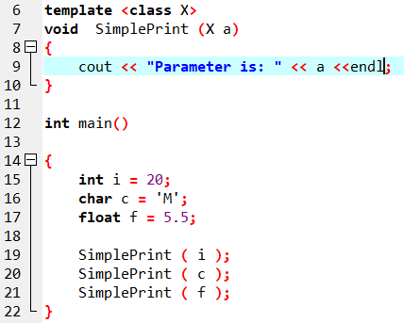
Example

Slide 15
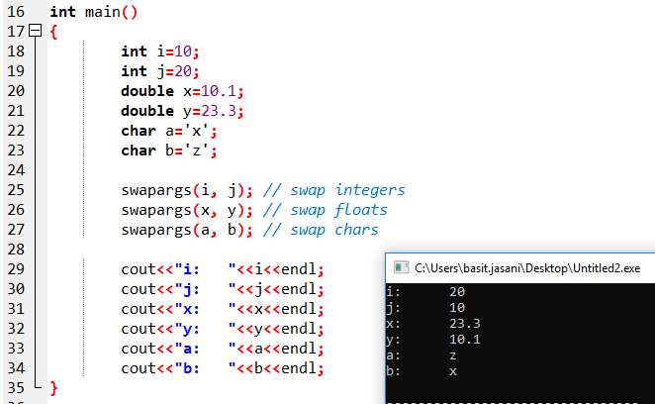
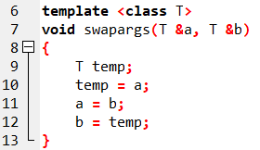
Example

Slide 16
Template Function with Two Generic Types
You can define more than one generic data type in the template statement by using a comma-separated list
template <class T1, class T2> void myfunc(T1 a, T2 b) { cout << a << “ & ” << b << '\n'; }

Slide 17
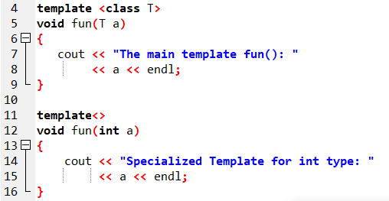
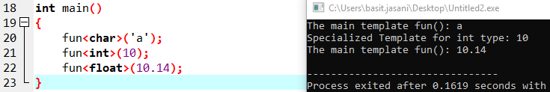
Specialized Template

Slide 18
Overloading a Generic Function
In addition to creating explicit, overloaded versions of a generic function, you can also overload the template specification itself
To do so, simply create another version of the template that differs from any others in its parameter list

Slide 19
Example
// First version of f() template // Second version of f() template
template <class X> template <class X, class Y>
void f(X a) void f(X a, Y b)
{ {
cout << "Inside f(X a)"; cout << "Inside f(X a, Y b)";
} }

Slide 20
Using Normal Parameters in Generic Functions
You can mix non-generic parameters with generic parameters in a template function:
template<class X> void func(X a, int b){
cout << “General Data: ” << a;
cout << “Integer Data: ” << b;
}

Slide 21
Generic Classes
In addition to generic functions, you can also define a generic class
The actual type of the data being used (in class) will be specified as a parameter when objects of that class are created
Generic classes are useful when a class uses logic that can be generalized e.g. Stacks, Queues

Slide 22
Generic Classes
The general form of a generic class declaration is shown here:
template <class T> class class-name
{
. . .
}

Slide 23
Generic Classes
If necessary, we can define more than one generic data type using a comma-separated list
We create a specific instance of that class using the following general form:
class-name <type> ob;

Slide 24
Example
template <class T1, class T2> class myclass {
T1 i;
T2 j;
public:
myclass (T1 a, T2 b) { i = a; j = b; }
void show( ) { cout << i << “ & ” << j; }
};

Slide 25
Example (cont.)
int main(){
myclass<int, double> ob1(10, 0.23);
myclass<char, char *> ob2('X', “Hello”);
ob1.show(); // show int, double
ob2.show(); // show char, char *
}

Slide 26
Using Non-Type Arguments with Generic Classes
In a generic class, we can also specify non-type arguments:
template <class T, int size> class MyClass
{
T arr[size]; // length of array is passed in size
// rest of the code in class
}

Slide 27
Example (cont.)
int main()
{
atype<int, 10> intob;
atype<double, 15> doubleob;
}

